Slide 1
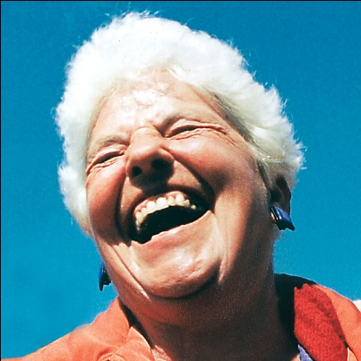
Emotional
Intelligence
Through Laughter Yoga

Slide 2
Ask Yourself Few Question ?
I stay relaxed and composed under pressure
2. I can identify negative feelings without becoming distressed
3. I stay focused (not lost in unimportant details) in getting a job done
4. I freely admit to making mistakes
5. I am sensitive to other people’s emotions and moods
6. I can conceive feedback or criticism without becoming defensive

Slide 3
Ask Yourself Few Question ?
7. I calm myself quickly when I get angry or upset
8. I communicate my needs and feelings honestly
9. I can pull myself together quickly after a setback
10. I am aware of how my behavior impacts others
11. I pay attention and listen without jumping to conclusions
12. I take regular time out (once a month or a quarter) to reflect on my core purpose and vision for how I want to live my life

Slide 4
EQ Vs IQ
Emotional Intelligence (EQ) versus Intellectual Intelligence (IQ)
90% of top performers have high emotional intelligence.
People with average EQs outperform those with the highest IQ 70% of the time
IQ only accounts for about 20% of our success
IQ can get you a Job
EQ decides If you will be fired or get Promotion

Slide 5
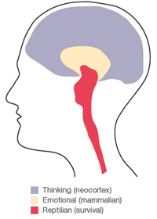
How Our Emotional Brains Evolved
The vital brain or Survival brain No feeling Brain :
This part of the brain controls vital functions, such as heart rate, blood pressure, respiration, and temperature. The vital brain is in the medulla and pons, which is part of the brain stem.

Slide 6
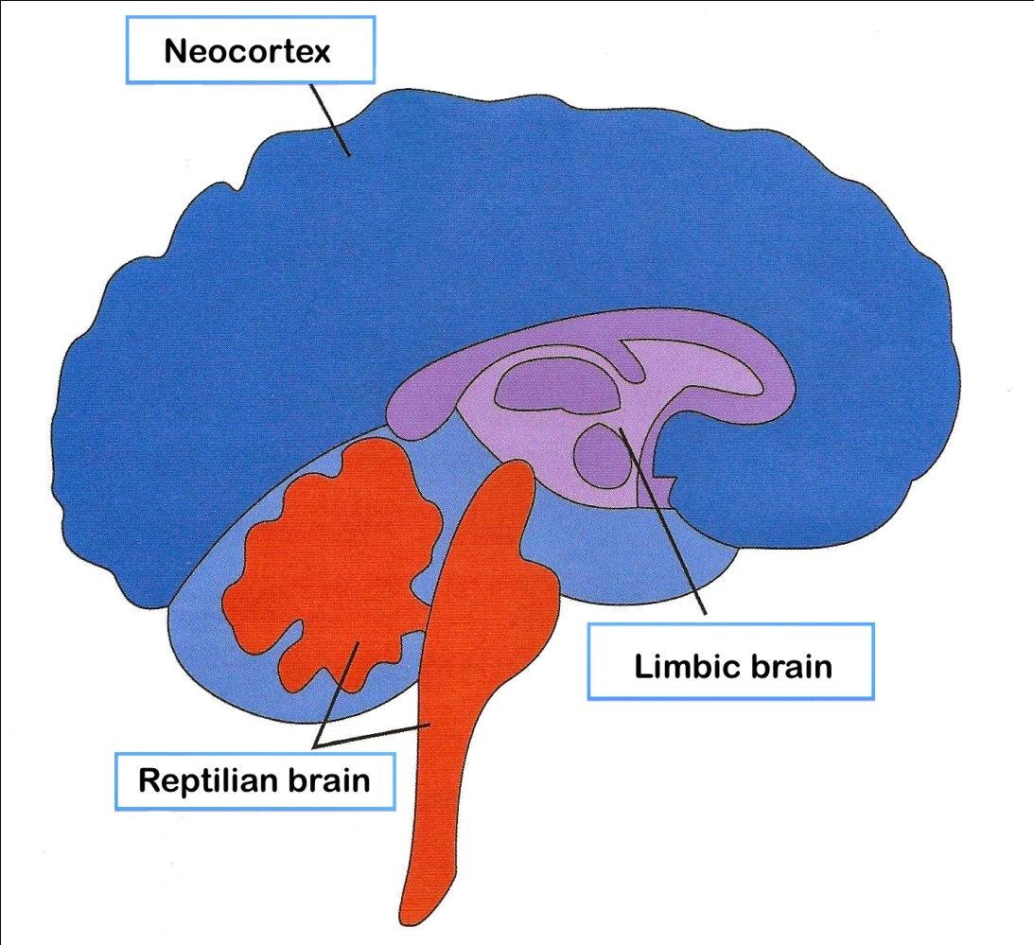
Emotional Brain / Feeling Brain - Limbic system
It is known as the mammalian brain because breast-feeding animals show affection and care towards their offspring. In humans, the emotional brain prepares a person to move toward love, or away from fear. Biologically, humans have the same capacity for unconditional love as other mammals.

Slide 7
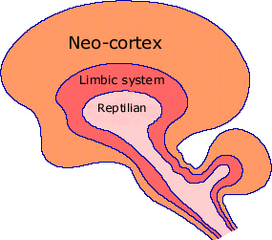
Human Brain, Neo-Cortex or Intellectual Brain
Process information
Think about the past, plan the future
Use computers and solve problems.
But we may also ruminate about the past and become anxious about the future.
This form of anxiety suppresses our emotional brain, leading us to live a life of information processing, judging others, and over-focusing on our problems.

Slide 8
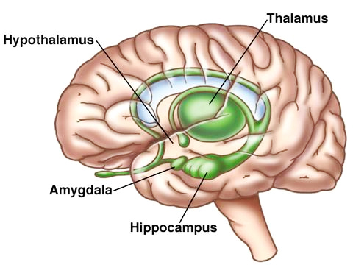
The Limbic System ( Emotional Brain )
The limbic system is a set of evolutionarily primitive brain structures located on top of the brainstem under the cerebral cortex . Limbic system structures are involved in many of our emotions Love fear, anger, related to survival and feelings of pain and pleasure such as eating and sex.

Slide 9
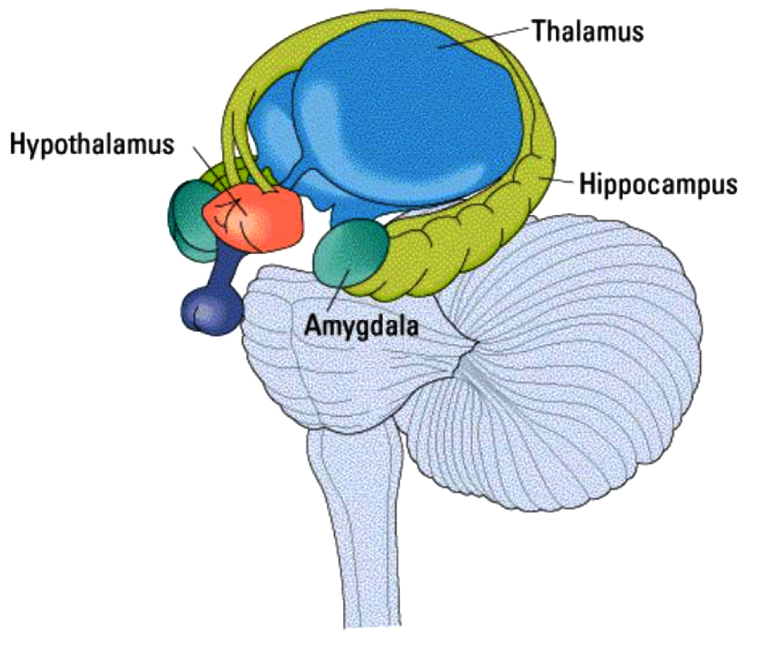
The Limbic System ( Emotional Brain )
Thalamus
( the clearing house or Information Hub)
Receives information from sensory organs.
( see, hear, touch, smell, or taste )

Slide 10
The Limbic System ( Emotional Brain )
Hypothalamus
The hypothalamus is responsible for regulating our survival instincts like hunger, thirst, response to pain, levels of pleasure, sexual satisfaction, anger and aggressive behavior.
It also regulates the functioning of the autonomic nervous system which in turn means it regulates things like pulse, blood pressure, breathing, and arousal in response to emotional circumstances.
It also controls the pituitary gland, The Master gland and responsible for releasing different hormones from different endocrine glands which maintains physiological and biochemical balance of the body which regulates growth and metabolism.

Slide 11
The Limbic System ( Emotional Brain )
Amygdala
(Reactive Brain or the watchdog)
It is the fear centre and reacts quickly to any situation without any rationale or reasoning to save our life. Responsible for Fight Flight Response when in emergency.

Slide 12
The Limbic System ( Emotional Brain )
Hippocampus
It helps in converting things that are “in your mind” at the moment (in short-term memory) into things that you will remember for the long run (long-term memory). acts as a memory indexer sending memories out to the appropriate part of the cerebral hemisphere for long-term storage and retrieving them when necessary.

Slide 13
Why We Need Emotions
To meet Basic Survival Needs
(food, shelter, clothes, health, security) (Wi Fi)
Emotional Needs
( to be loved, cared, appreciated and acknowledged)
Pleasures and Comforts
(enjoyment, freedom, peace harmony)
What we DON’T want
Discomfort, pain, criticism, obstacles to fulfillment and goals

Slide 14
What is EMOTION ?
E and Motion
Energy that moves our body and mind to take some action
To do something to get what is most important in our lives
To keep away what comes in way of your fulfillment

Slide 15
What is Emotional Intelligence ( EQ)
Emotional intelligence is the ability to identify, use, understand, and manage
YOUR EMOTIONS
EMOTIONS OF OTHERS
And how we manage behavior, navigate social complexities, and make personal decisions to achieve positive results
Relieve stress
Communicate effectively
Healthier relationships
Overcome challenges
Defuse conflict
Achieve success at work
Satisfaction peace harmony

Slide 16
How We Generate Emotions ?
Sources of Thoughts
External World
(Objects, People and Events)
Internal World
Past Experiences stored in Subconscious mind
Thoughts Emotions
Intellect
(Reasoning and Judging Ability)
Emotions Physiological reactions in the body Feelings

Slide 17
Types of Emotions
Positive emotions
Feeling of pleasure love and happiness
Draws people close to you
Negative emotions
Brings discomfort, pain
Drives people away or you run away

Slide 18
TYPE A & TYPE C
TYPE A BEHAVIOR
Very Active Restless
Sense of Urgency
Excessive Competitiveness,
Hostile and Aggressive ( Go Getter)
Walk, Talk, and Eat Faster
Afraid of losing Money and precious Time.
Express by Anger
High Blood Pressure & Heart Disease
TYPE C BEHAVIOR
Passive and Slow
Suffer Silently
Bottling-up Emotions
First Resist Feel Resentment Rejection & Suppression
Emotional numbness .
Cancer and Autoimmune disease

Slide 19
Emotions And Making Decisions
We make decisions in two ways:
Decision from the Logical Mind- when people make decisions from logical thinking it takes a long time for people to decide.
Decisions from the Emotional Mind- when on the emotions people are very quick to make decisions and hence they are put into action. Only we need to figure out, the decision-making from the emotional mind as to be rationalized before taking action.

Slide 20
Emotional Balance
Intensity of Emotional Responses
Neither Suppression Nor Extreme Expression
Extreme Expression
Intense & Consuming
Overwhelming
Hyper-Vigilance
(Always Looking for danger)
Suppression
Complete lack of Feeling & Passion
emotionally shut down, or numb

Slide 21
Exercise – Express your EMOTIONS
LOVE ROMANCE
SADNESS
JOY
ANGER
FEAR
SURPRISE
DISGUST
PEACE AND CONTENTMENT

Slide 22
How to Manage YOUR Emotions
Self-awareness
Recognise your own emotions and how they affect your thoughts and behavior, know your strengths and weaknesses, and have self-confidence.
Self-management
Control impulsive feelings & behaviors, manage your emotions in healthy ways, take initiative, follow through on commitments, and adapt to changing circumstances.

Slide 23
Managing OTHER People’s Emotions
Social awareness
Understand emotions, needs, and concerns of other people, pick up on emotional cues, feel comfortable socially, and recognize the power dynamics in a group or organization.
Relationship management
Develop and maintain good relationships, communicate clearly, inspire and influence others, work well in a team, and manage conflict.

Slide 24
EGO Mind
Your ego is your conscious mind, the part of your identity that considers self as supreme.
I My and Me
-False sense Importance
- I am the center of the universe
- My way the right way
- Based on fear of losing self
- FEAR of insignificance

Slide 25
You Know Your Strengths and Weaknesses
Emotionally intelligent people don’t just understand emotions; they know what they’re good at and what they’re terrible at. They also know who pushes their buttons and the environments (both situations and people) that enable them to succeed.
Having a high EQ means you know your strengths and you know how to lean into them and use them to your full advantage while keeping your weaknesses from holding you back.
Home Work
Please Identify Strengths and Weaknesses

Slide 26
Difference Between Needs And Wants
NEEDS are absolutely necessary for survival
WANTS : I would like to have if have resources, mostly for pleasures and comforts
Home Work?
Please Identify your needs & wants
Write your Financial Goals. How much money you need and why?

Slide 27
What Is Emotional Hijacking?
Action First Thinking Later (Love at First Sight)
Why People Fall in Love Why Not Rise in Love
These emotional reactions are so immediate that the “thinking brain” doesn’t get a chance to provide a reality check before action is taken.

Slide 28
Preventing Emotional Hijacking
Immediate Solution when Mind is ready to take action no time for thinking
Activating Parasympathetic System
Diaphragmatic ( Belly Breathing )
Synchronised Breathing

Slide 29
Emotional Scan (Reality Check)
When you are about to take some action and have time to think
Is this really important to me? If so, which part of me—my ego self or higher self
Are my expectations realistic? Or I am living in Dream world
Can I let it go, or is it a recurring challenge that needs to be dealt with?
4. Will this matter in a week? In a year?
5 What are the consequences if I do—or don’t—act on this emotion?

Slide 30
Unconditional Giving
When someone gives you something spontaneously, without expecting anything in return, this leaves a powerful impression.
Giving, Empathy, caring sharing - gateways to a high EQ.
Why People Worship trees in India- Giving is a great spiritual value

Slide 31
Imperfect is Perfect
Emotionally intelligent people won’t set perfection as their target because they know that it doesn’t exist.
Seeing beauty in imperfection is japanese art of wabi sabi
Imperfections put together makes perfection

Slide 32
You Embrace Change- Be Flexible like River
Emotionally intelligent people are flexible and are constantly adapting. They know that fear of change is paralyzing and a major threat to their success and happiness.
They look for change that is lurking just around the corner, and they form a plan of action should these changes occur

Slide 33
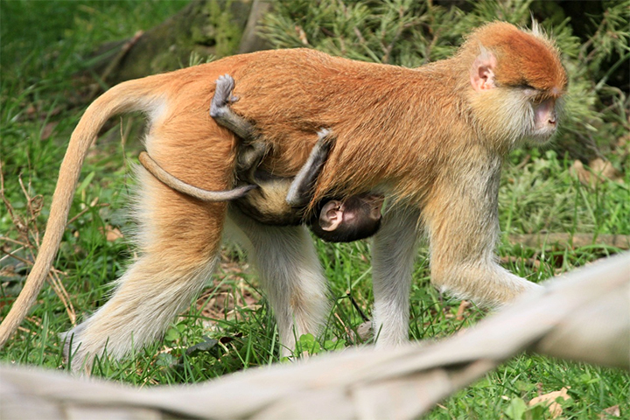
Surrender into the Universe
Learn to Surrender to The Universe
Baby Monkey Holding on to Mother Monkey

Slide 34
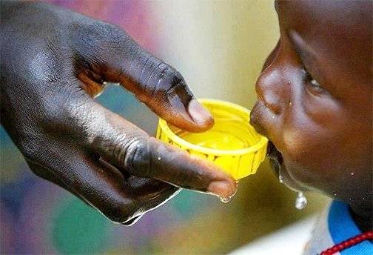
Appreciate What You Have
People who worked daily to cultivate an attitude of gratitude experienced improved mood, energy, and physical well-being.
It’s likely that lower levels of cortisol played a major role in success.

Slide 35
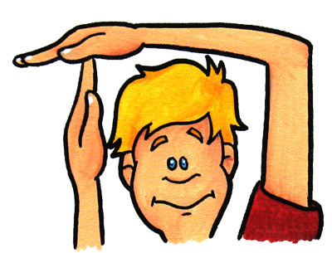
Take A Break
Taking regular time off is a sign of a high EQ because it helps you to keep your stress under control and to live in the moment.
When you make yourself available to your work 24/7, you expose yourself to a constant barrage of stressors. Forcing yourself offline and even—gulp!—turning off your phone gives your body and mind a break.

Slide 36
You Get Enough Sleep
It’s difficult to overstate the importance of sleep to increasing your emotional intelligence and managing your stress levels. When you sleep, your brain literally recharges, shuffling through the day’s memories and storing or discarding them (which causes dreams) so that you wake up alert and clearheaded.
High-EQ individuals know that their self-control, attention, and memory are all reduced when they don’t get enough—or the right kind—of sleep. So, they make sleep a top priority.

Slide 37
You Limit Your Caffeine Intake
Drinking excessive amounts of caffeine triggers the release of adrenaline, and adrenaline is the source of the fight-or-flight response.
When caffeine puts your brain and body into this hyper-aroused state of stress, your emotions overrun your behavior.
High-EQ individuals know that caffeine is trouble, and they don’t let it get the better of them.

Slide 38
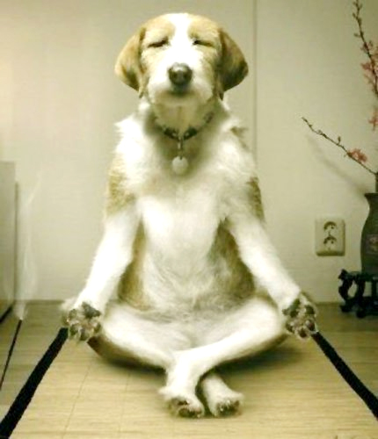
Meditate and Recharge
Two types of Meditation
Dynamic
Still Meditation

Slide 39
You Know How to Say No ( Yourself and Others)
Saying no is indeed a major self-control challenge for many people.
“No” is a powerful word that you should not be afraid to say “NO”.
Saying “No” to a new commitment honors your existing commitments and gives you the opportunity to successfully fulfill them.

Slide 40
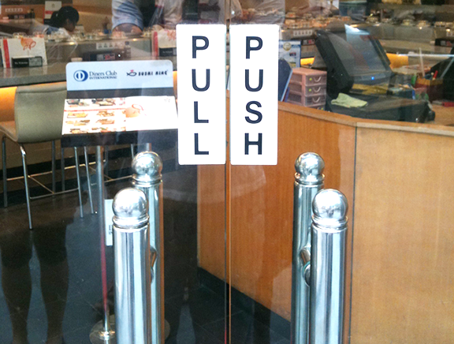
Staying Calm With Difficult People
High EQ individuals control their interactions with toxic people by keeping their feelings in check. When they need to confront a toxic person, they approach the situation rationally.
They exactly know when to PULL & when to PUSH
They identify their own emotions and don’t allow anger or frustration to fuel the chaos. They also consider the difficult person’s standpoint and are able to find solutions and common ground.

Slide 41
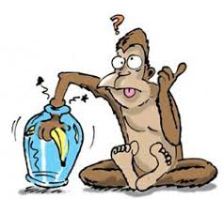
Don’t Hold Grudges - Let Go
Hatred is like a poison you are drinking expecting other person to die- Gandhi
Learning to Let go Forgive and forget
How People catch Monkeys in India

Slide 42
5 Key Skills you can Get with LY for EQ
Get rid of old baggage : Catharsis letting go of old baggage
Quick Stress Reduction- Quick tool to reduce stress
Creativity : Play is essential skill for creativity.
Positive mental State change the chemistry to change the thoughts and hence your perception Optimism and Hope.
Practice spiritual values virtues : Truthfulness honesty generosity forgiveness
EMOTIONAL CLEANSING EXERCISE SLD BREATHING

Slide 43
Dr. Madan Kataria
Founder Laughter Yoga Movement
Mob: +91 9819822226
http://www.laughteryoga.org
http://www.youtube.com/laughteryoga
http://www.facebook.com/laughteryoga

